Slide 1
Linear Modeling
Yoav Gilad
Human Genetics department
CLSC room 325C
Phone: 773-702-8507
Email: gilad@uchicago.edu

Slide 2
Study design: inherent variability in genomic data
y = βx+c+ε
β =0
y = βx+c+ε
y is the observation (e.g., expression level)
x Is the treatment (e.g., diseased or not)
β is the effect
ε is the error (unexplained variance)
β =0
Notes:
Reasons why we do not see a significant departure from null:
Treatment does not cause an effect
Error is too high to see the effect (possibly did not take into account an important factor, this can be fixed by including another dimension (aka a third or more variable)

Slide 3
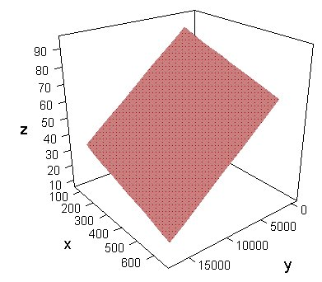
Study design: inherent variability in genomic data
y = β₁x+β₂z+c+ε
Notes:
Added variable decreases the E and :. Increases our “resolution” so to speak

Slide 4
Outline:
What kinds of questions are we answering using genomic data?
What are linear models? When should I use them? What are the assumptions that need to be met?
Why use multiple testing correction and how do I do that?
What is logistic regression? When do I use it versus linear regression?

Slide 5
Statistics you are assumed to know
Descriptive/exploratory statistics (ex: scatterplots, numerical summaries)
Estimation and confidence intervals
Hypothesis testing
Parametric vs. non-parametric inference
Maximum likelihood estimation; likelihood ratio tests

Slide 6
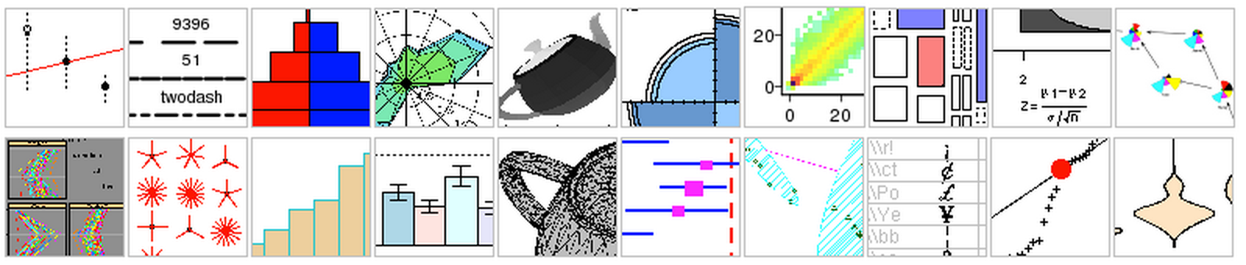
Why R?
Free software environment (http://www.r-project.org/)
Easy tools for data management
A wide variety of statistical and graphical techniques
User-submitted packages
Bioconductor: R packages for the analysis of genomic data (http://www.bioconductor.org/)

Slide 7
Classic Problems
Differential expression (DE) and linear models
  Case-control studies
  Longitudinal studies
Classification (assign object to a priori-defined categories)
  Classification of disease state (Golub et al 1999)
  Personalized medicine
Clustering of data
  Cluster samples on expression profiles
  Co-expression as a predictor of common function
  Discovery of regulatory elements
  Co-clustering of genes and conditions (these are “first order estimates”
Gene co-expression networks
Notes:
At this point, we can use large data sets to predict a disease state, without outlining the mechanism

Slide 8
DE in microarray experiments
Goal: identify genes for which expression levels are associated with the condition
  Qualitative (treatment)
  Quantitative (dose)
Biological vs. technical replicates
Data is a g x n matrix (g genes and n = n₁ + n₂ samples)
Entries
  (log) intensity (or other expression measure)
  Filtering can be used to remove “uninteresting” genes
  Data quality – outliers, intensity, variability
  Biological knowledge
do not filter BASED ON YOUR HYPOTHESIS, might introduce
variance
Notes:
DE = differential gene expression
Sometimes when analyzing data, you can choose between a qualitative analysis or a quantitatively (Ex. is there binding? Yes or no = quality, vs. < 0.005 = a true binding effect
Can simulate to determine whether to do this qual. And quant. Gives you the most powerful method
G = gene, n = number of samples
Why do care to distinguish between biological and technical replicates: it will determine where/what you will repeat to increase your power of analysis
Nested: variation w/i variation (ex. RNA extraction and RNA library are merged into one variable as “RNA prep error”
Ex. looking for DE, do not through out the bottom data that is least DE and then try to drop your # genes tested b/c then you have a high + in a falsely small sample size
Qqplot= look it up

Slide 9
What is regression?
Regression analysis: a mathematical measure of the average relationship between two or more variables (in the original units of the data)
Types of regression:
  Simple regression: (one variable)
    Height ~ age?
  Multiple regression: (more than one variable)
    Height ~ age + nutrition?
  Linear: if the relationship between values is a straight line
  Non-linear/curvilinear: if the relationship between values is not a straight line

Slide 10
What is regression?
Uncorrelated predictors:
Total variance of height
Variance explained by age
Variance explained by nutrition
Correlated predictors:
Total variance of height
Variance explained by age
Variance explained by sex
Notes:
Ex. age and sex might be linked/correlated b/c men and women hit growth spurts at different ages

Slide 11
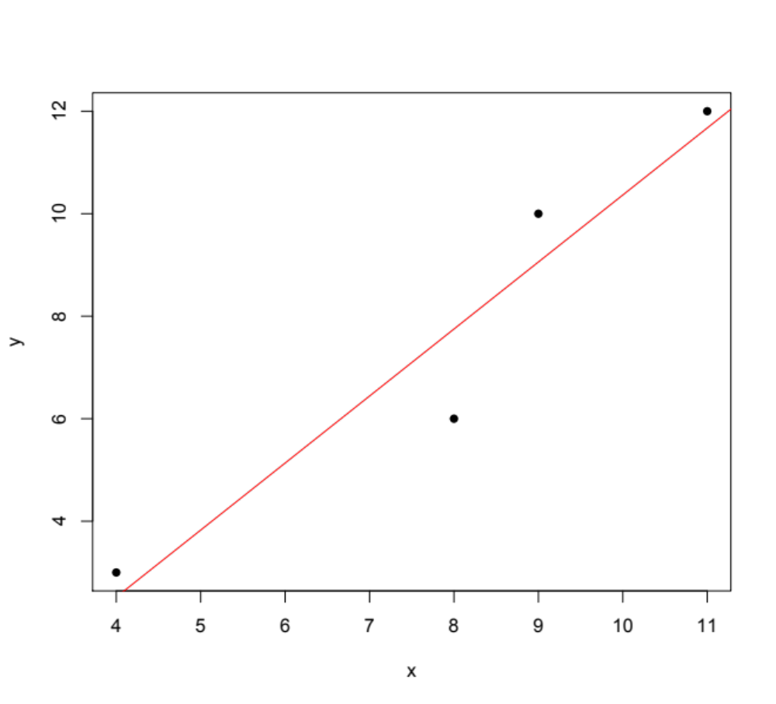
What is a linear model?
observed value

Slide 12
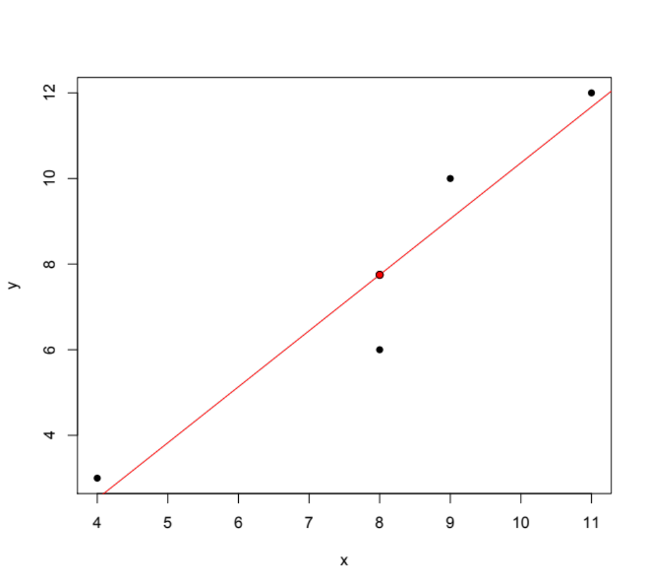
What is a linear model?
predicted value
observed value
residual
Notes:
How to ask: how well does this line fit my data?
Residual = difference between predicted value and observed value

Slide 13
Linear Modeling
Assumptions:
  X is measured without error
  Relationship is linear
  Errors are independent
  Errors have normal distribution
  Errors have constant variance
Why linear?
  Simple to estimate, analyze, and interpret
  Fits with many cases where the relationship between two phenomenon is linear
  If the relationship isn’t linear, there are many transformation methods that can be applied to the data to get a linear relationship
Notes:
Errors are dependent = nested errors?
You can “softly violate” the idea that your errors have a normal distribution
You lose power when errors have constant variance, but it shouldn’t give you a false result

Slide 14
Steps in analysis
1. Determine the variables to be examined
2. Estimate the parameters in the model (the βs)
3. Hypothesis tests on on the estimated betas
4. Robustness check of the model
5. Use the model to analyze the causal effect or do forecasting

Slide 15
Steps in analysis
1. Determine the variables to be examined
2. Estimate the parameters in the model (the βs)
3. Hypothesis tests on on the estimated betas
4. Robustness check of the model
5. Use the model to analyze the causal effect or do forecasting

Slide 16
1. Chose variables: Linear Models - the general structure
A response variable, Y (for example, expression level)
The covariates: several predictor/explanatory variables, X, that model
  Treatment effects
  Probe characteristics
  Array effects (normalization)
  Gender, age, etc
  interactions
The model that links them
Y ~ β₀ + β₁X₁ + …+ β_{p}X_{p} + ε
The error term distribution, e.g. ε ~ N(0,σ²)
Notes:
Alternative to adding an extra variable on your data, you can normalize based on the confounding variable
What assumption is made: that all your data will be equally effected by

Slide 17
1. Choose variables: The response variable Y
Y can be a quantitative variable
  Examples: BMI, log-intensity of probe
  Q: How should we model the distribution of Y?
  A:
Y can be a binary variable
  Examples: case-control, two-treatments
  Q: How should we model the distribution of Y?
  A:
Y can be count data
  Examples: the number of reads that align to an exon
  Q: How should we model the distribution of Y?
  A:
Notes:
Normal (only has one parameter)
Binomial (usually doesn’t happen in biology, and over-dispersion is occurring)
Poison
How should we model a distribution with an extremely small sample size. (how should we model this? Over-dispersion is occurring

Slide 18
1. Choose variables: Covariates - Dummy variables
Used to incorporate qualitative variables
0 – 1 variables
Example: gender. Define X = 1 is male and X = 0 is female
Several categories:
  Example: control, treatment A, and treatment B
  Can define X_{A} = 1 for A and X_{A} = 0 if otherwise (X_{B} similarly)
  k groups lead to k or (k – 1) dummy variables
Notes:
Write down what the y intercept stands for

Slide 19
1. Chose variables: Fixed and Random Effects
Fixed effects
  Levels are identical in repeated experiments
  Example: gender (two levels, M and F)
  Interest: estimate the differences between mean values for each level
  OR you want to estimate the variance for this gene’s expression based on your small sample (but this would be an example of trying to determine a random effects)
Random effects
  Levels represent a sample from a distribution/population of levels
  Levels are different in replicated experiments
  Example: Individual variation in a two group study
  Example: S ~ N(0,σ²)
  Interest: variability associated with a random effect
Notes:
Individual variation = variation between individuals in the same group, NOTE: you can underestimate variance this way, b/c all individuals in the group have something in common obviously, which would/could derease variance

Slide 20
1. Choose variables: Error term
ε ~ N(0,σ²)
Error term captures:
  the effect on the dependent variable of any covariates not included in the model
  Specification error related to assumed linear functional form
  Unpredictable random components present in the dependent variable
Notes:
Over-fitting
Degrees of freedom: independent variables that can affect the end result

Slide 21
1. Choose variables: Model considerations
If we want a model that fits our data well, why not include all parameters we can think of?
Degrees of freedom:
  df = n – k – 1
  n = sample size
  k = number of parameters
Over-fitting
the number of independent pieces of information available to estimate another piece of information
random vectors are constrained to lie in linear subspaces, and the number of degrees of freedom is the dimension of the subspace

Slide 22
1. Choose variables: Example of model building
We have data from our favorite collaborators who want to know how medication predicts liver function.
Goal: find genes that have altered expression in subjects taking different drugs
Subjects: there are three groups of subjects
  Drug A
  Drug B
  Control (no drug/placebo)
Relevant variables:
  Gender
  Ethnic origin (Caucasian, African-American, Hispanic)
  Age
  BMI
Microarrays (15000 genes) on 105 subjects
Three technical replicates for each subject

Slide 23
1. Choose variables: Example of model building
For a given gene:
Y_{ij} ~ β₀ + β₁A_{i} + β₂B_{i} + β₃G_{i} + β₄C_{i} + β₅H_{i} + β₆X_{i} + β₇S_{i} + ε_{ij}
i = 1,2,…,105 (subjects); j = 1,2,3 (replicates)
Y_{ij} is the gene expression measurement for your gene in the i^{th} individual, the j^{th} replicate
A is a dummy variable for drug A (1 if subject took drug A, 0 if not)
B is a dummy variable for drug B (1 if subject took drug B, 0 if not)
G is a dummy variable for gender (1=female, 0=male)
C is a dummy variable for Caucasian (1=Caucasian, 0=not Caucasian)
H is a dummy variable for Hispanic (1=Hispanic, 0=not Hispanic)
X is a variable for age
S is a random effect (estimated for the gene)
ε is the error
Notes:
What is the random effect?
Y-intercept will be where all variables are set to 0, write it out:
Ask whether the betas are different from eachother b1- _b2____ unequal to 0
If you set a ridiculous null, then you will always get that it is not supported, but this could mean that: the opposite is true, that one part of you hypothesis is not true, or that only your null isn’t true

Slide 24
Steps in analysis
1. Determine the variables to be examined
2. Estimate the parameters in the model (the βs)
3. Hypothesis tests on on the estimated betas
4. Robustness check of the model
5. Use the model to analyze the causal effect or do forecasting
Notes:
Parameters are determined from the beta’s

Slide 25
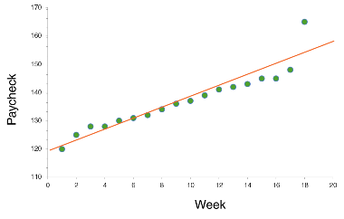
2. Estimate parameters
Method of least squares:
  Determine the coefficients of a line that when plotted through the points in such a manner that the sum of the square of the vertical deviations of actual Y values from estimated Y values is the least
  Σ(Y-Y_{e})²
  This is known as the line of best fit

Slide 26
Steps in analysis
1. Determine the variables to be examined
2. Estimate the parameters in the model (the βs)
3. Hypothesis tests on on the estimated betas
4. Robustness check of the model
5. Use the model to analyze the causal effect or do forecasting

Slide 27
3. Hypothesis tests on estimated betas/model
Goodness of fit: R²
F-test:
  H₀: β₁ = β₂ = ,…, = β_{p} = 0
  H₁: β_{j} != 0, for at least one value of j
    MSM = Mean of squares for the model (SSM/DFM)
    MSE = Mean of squares for the error (SSE/DFE)
    DF(M/E) = Degrees of freedom for the model/error
  F = MSM/MSE (explained variance/unexplained variance)
  Find a (1-α)*100% confidence interval for (DFM, DFE) degrees of freedom from F-table
  Reject null if F doesn’t overlap the confidence interval
  http://facweb.cs.depaul.edu/sjost/csc423/documents/f-test-reg.htm

Slide 28
Steps in analysis
1. Determine the variables to be examined
2. Estimate the parameters in the model (the βs)
3. Hypothesis tests on on the estimated betas
4. Robustness check of the model
5. Use the model to analyze the causal effect or do forecasting

Slide 29
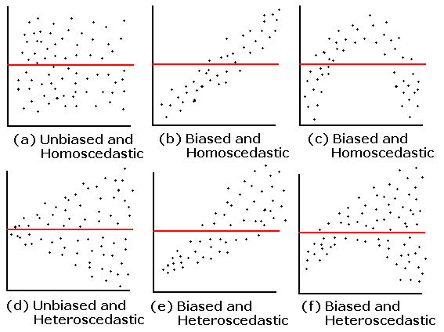
4. Robustness checking: Model Checking
After generating a model, robustness can be checked using the following methods:
  Graphically: plot residuals vs. fitted values
http://condor.depaul.edu/sjost/it223/documents/regress.htm

Slide 30
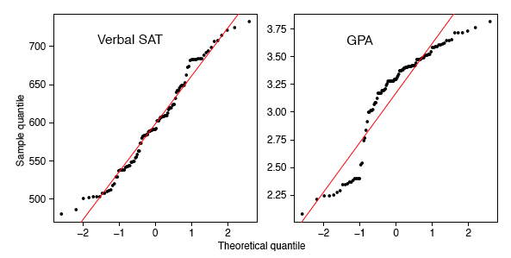
4: Robustness checking: Model Checking
After generating a model, robustness can be checked using the following methods:
  qq-plot for normality
http://onlinestatbook.com/2/advanced_graphs/q-q_plots.html
Notes:
Plot on the right= not re
Restricted range problem = means you are only sampling a portion of the data when testing your hypothesis

Slide 31
Extras: Multiple Hypotheses
Controlling for false positives:
Bonferroni correction:
  Divide your desired p-value threshold by the number of tests.
  0.05/15000 genes = 3.33x10⁻⁶
  Conservative
FDR – Benjamini and Hochberg, 1995
  Order the unadjusted p-values from smallest to largest
  To control FDR at level α, find the max j st p_{j} < αj/m
  Reject the null for all p-values smaller than the corresponding p_{j}
q-value – Storey, 2002
  - The minimum pFDR at which a feature is significant

Slide 32
Logistic regression
Logistic regression: statistical method for analyzing whether one or more independent variables are associated with an outcome. The outcome is a dichotomous variable, where there are only two possible outcomes.
Coefficients predict a logit transformation of the probability of presence of the characteristic of interest.
Assumptions:
  Linear relationship between the logit (log of the odds) of the IVs and DVs
  No assumptions about normality, linearity, and homogeneity of variance for the independent variables
Considerations:
  Need larger sample sizes compared to linear regression

Slide 33
Logistic regression
Logit p = α +β₁X₁ + β₂X₂ + …+β_{P}X_{p}
α represents the overall disease risk
β₁ represents the fraction by which the disease risk is altered by a unit change in X₁
β₂ is the fraction by which the disease risk is altered by a unit change in X₂
These betas represent changes in the log odds. The odds themselves are changed by e^{β}
  if β = 1.6, the odds are e^{1.6} = 4.95
  (odds of success = P/(1-P))

Slide 34
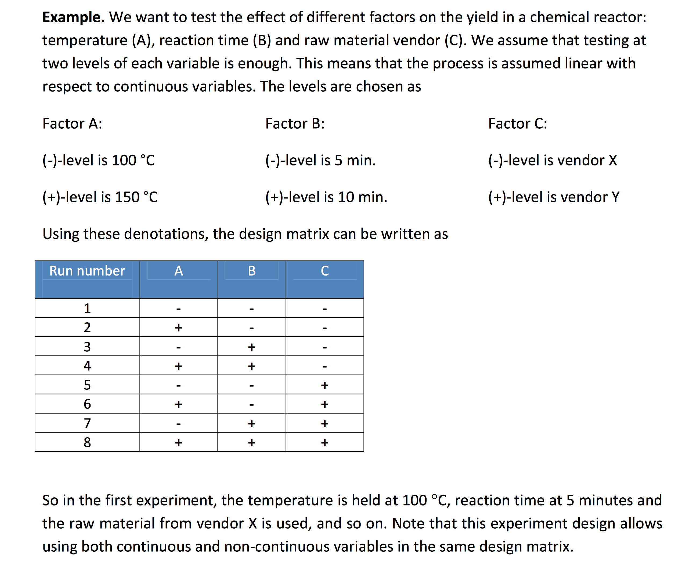
Kauko Leiviskä

Slide 35
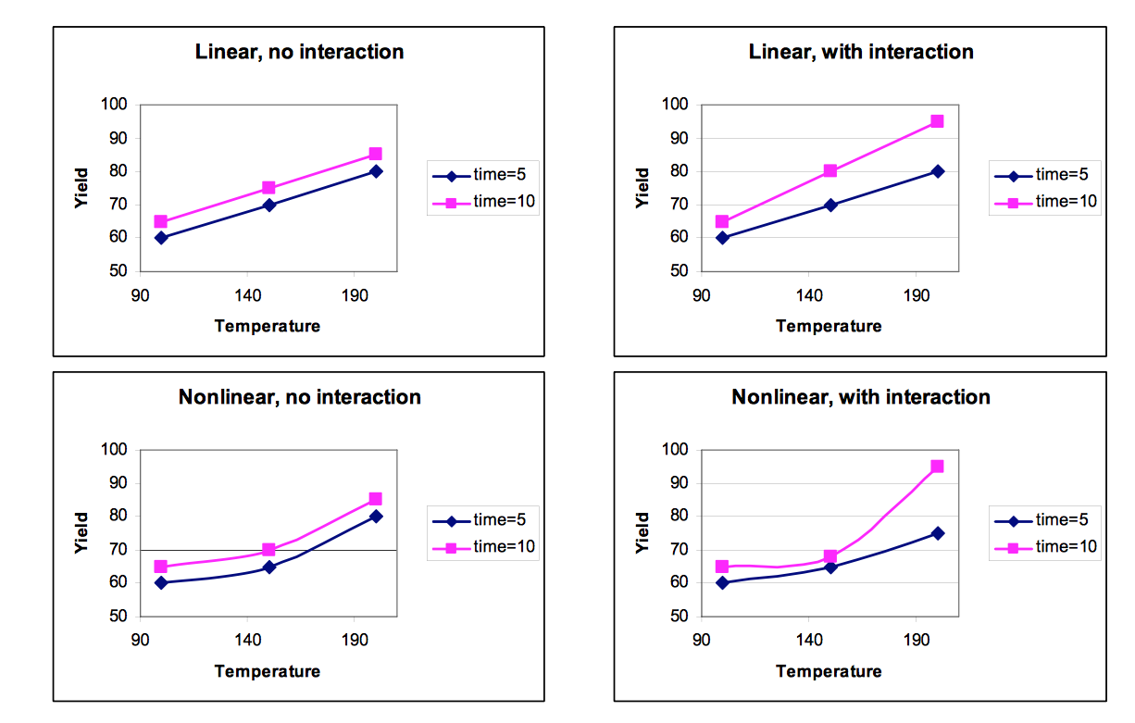
Kauko Leiviskä

